Slide 1
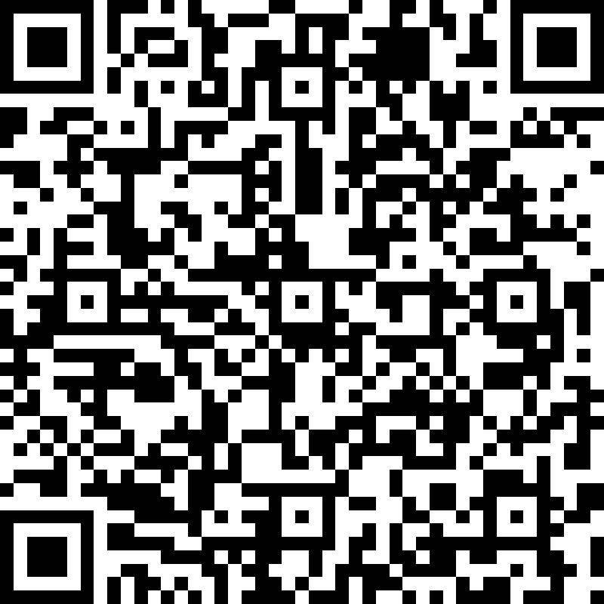
Academic Meeting FOR DMS Current 7th Graders
Agenda
Explanation of Required classes
Physical Education
Band
Explanation of Electives for incoming 7th Graders in 2022
Cyber Foundations I or II
Visual Arts
Explanation of sections on form
Questions, Comments, Concerns, Suggestions
QR Code Please
scan with camera phone to
sign in

Slide 2
Please select ONE of the following electives:
____________ Band: Instrument Played __________________
____________ Physical Education (PE)
Students are to select either Band or PE for 7th grade.
1. Student are NOT allowed to take both
2. When selecting Band, student must include the instrument played
a. Band classes are divided into specific areas: Woods, Winds, and Brass
B. If you are a beginner, please write that as well

Slide 3
Please select ONE of the following three electives:
____________Cyber Foundations I (1 High School Credit)
OR
____________ Cyber Foundations II (1 High School Credit)
Perquisite of Cyber Foundations I
OR or
______________ Visual Arts (1 High School Credit)
Information:
ALL classes will earn student 1 credit towards High School Graduation upon completion and passing of class.
Visual Arts I is offered in high school as well

Slide 4
Please select ONE of the following options if you were a Gifted/Journey Student in the 7th Grade
Option 1:
______________8th Grade Journey (must have been enrolled in Journey as a 7th^{th} grader; NO credit given toward high school graduation)
OR
Option 2:
______________ Mississippi Studies (1/2 high school credit toward graduation when completed and passed)
______________ World Geography (1/2 high school credit toward graduation when completed and passed)

Slide 5
